Slide 1
Ayurveda Medicine

Slide 2
Introduction
Ayurveda is an ancient Indian system of medicine that focuses on holistic health and wellness.
It uses natural remedies and treatments to promote well-being.
Introduction to the importance of Ayurvedic medicine in today's world of increasing health challenges.

Slide 3
Current challenges
Limited availability of specific Ayurvedic medicines in local stores.
Difficulty in finding qualified Ayurvedic practitioners in certain areas.
Lack of a centralized platform for easy access to Ayurvedic medicines and practitioners.

Slide 4
Our Solution: Ayurvedic Medicine Booking System
Introduce your online platform as a solution to these challenges.
Highlight how the system will provide easy access to a wide range of Ayurvedic medicines and practitioners.

Slide 5
Key Features
User-friendly interface: Easy navigation for users to search and book medicines/practitioners.
Secure online transactions: Safe payment options for users.
Comprehensive database: Extensive list of medicines and practitioners for users to choose from.
Appointment scheduling: Option to book appointments with preferred practitioners.

Slide 6
How It Works
User Registration: Users create an account on the platform.
Search for Medicines/Practitioners: Users search for specific medicines or practitioners.
Select Items: Users select the medicines or practitioners they want to book.
Confirm Booking and Payment: Users confirm their booking and make payment online.
Receive Confirmation: Users receive a confirmation of their booking along with appointment details.

Slide 7
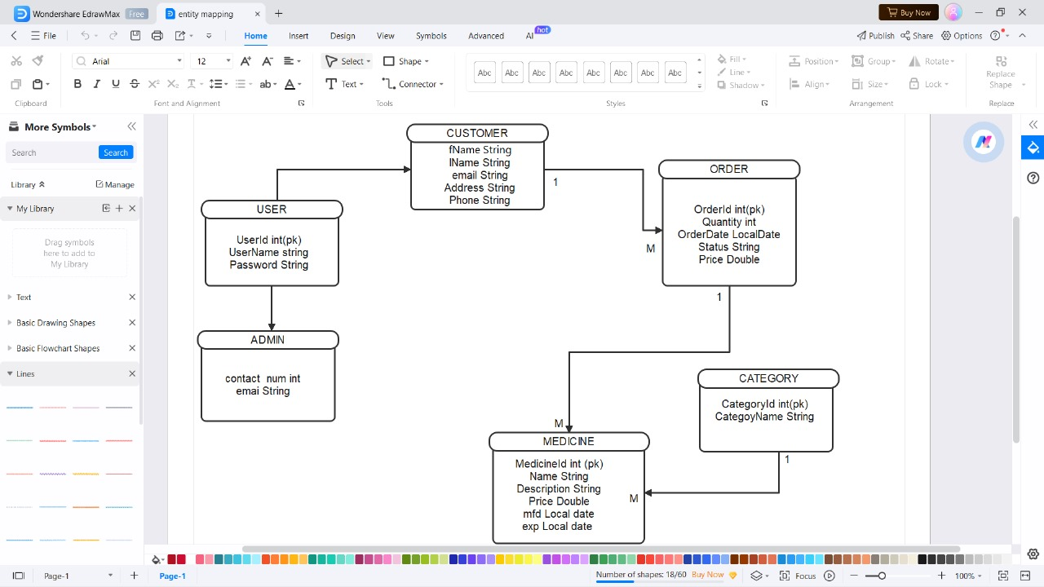

Slide 8
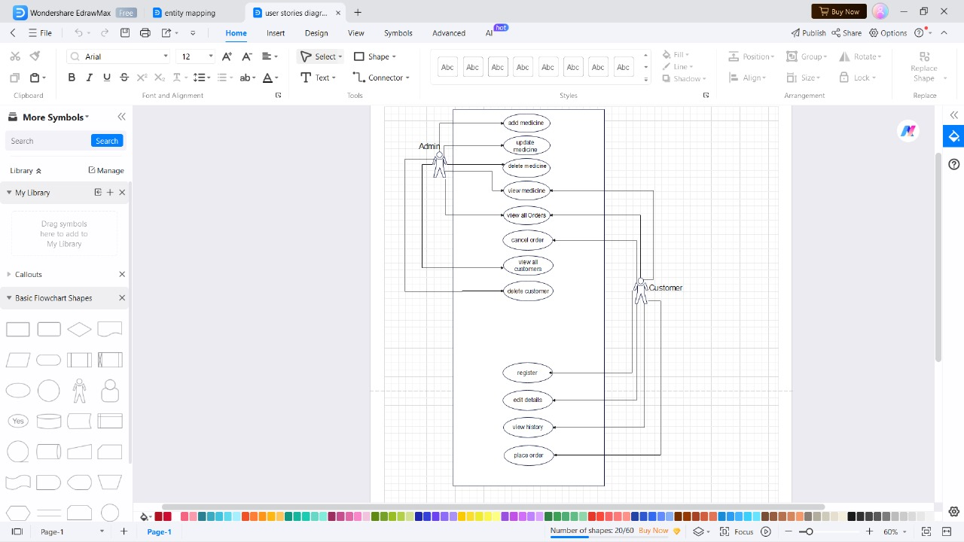

Slide 9
Benefits For Users
Convenient access to a wide range of Ayurvedic medicines.
Easy booking and scheduling of appointments.
Secure and hassle-free transactions.

Slide 10
Future Enhancements
Mobile App Integration: Develop a mobile app for easy access on smartphones.
Teleconsultation Options: Introduce teleconsultation features for remote consultations.
Personalized Recommendations: Use AI to provide personalized recommendations for users based on their health needs.

Slide 11
Conclusion
Summarize key benefits and features of the Ayurvedic Medicine Booking System.
Encourage the audience to try the platform for easy access to Ayurvedic medicines and practitioners

Slide 12
Thank you
Thank the audience for their attention.
Provide contact information for further inquiries or partnership opportunities.
Include a website link for more details about the platform

